Slide 1









PraderCare
Presented by The Health hackers
Our Teams:
Ayesha Farhana
Sumanth Komallapalli
Ganesh Prasad Bhandari
Nishal Sukumar

Slide 2
PROBLEM STATEMENT
We have selected Symptom Management (Part-F) as our problem statement, contributed by IPWSO.
Within this, we have chosen to build an accessible, multilingual platform for the care taker of the Prader Willi syndrome patients.

Slide 3
INTRODUCTION
Prader-Willi syndrome (PWS) is a multisystem disorder affecting 1 in 10,000 to 1 in 30,000 people. It starts with severe hypotonia and feeding difficulties in infancy, followed by excessive eating and obesity in early childhood unless controlled.
PWS occurs due to the lack of expression of paternal genes on chromosome 15q11.2-q13. These genes are normally active only on the paternal chromosome, while the maternal copies are silenced. The absence of these paternal genes leads to PWS symptoms.

Slide 4
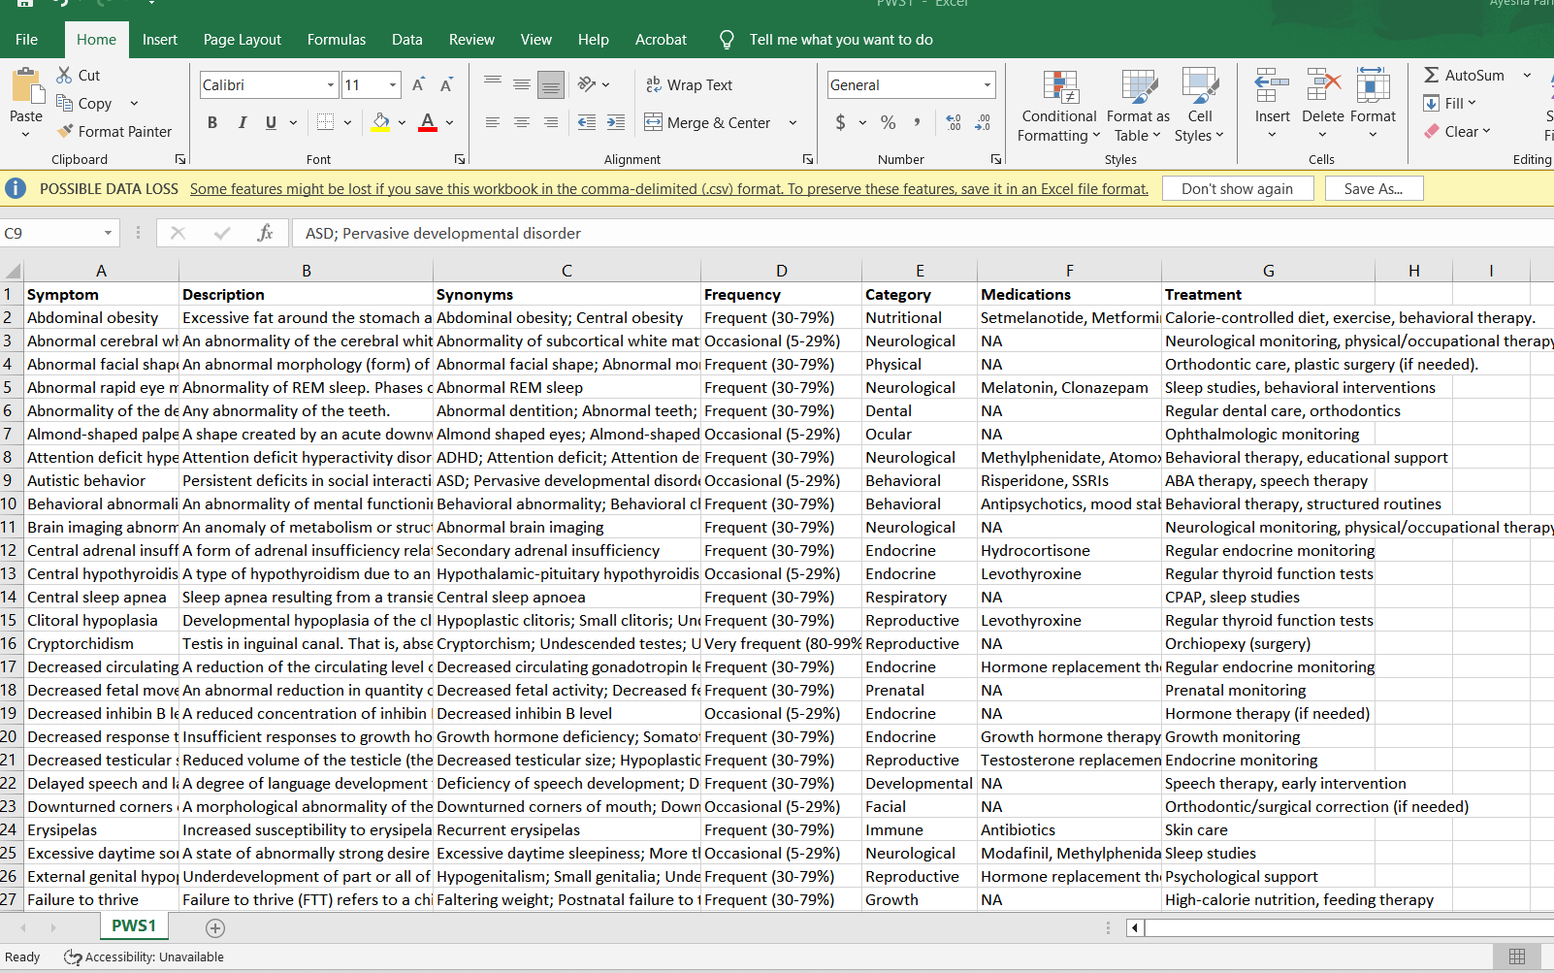
DATA
https://rarediseases.info.nih.gov/diseases/5575/prader-willi-syndrome

Slide 5
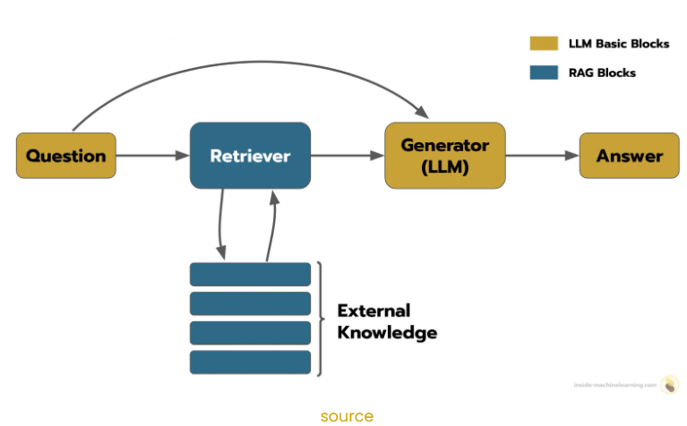
ARCHITECTURE
PraderCare Connect : AI Powered Multilingual Care Taker Assistant

Slide 6
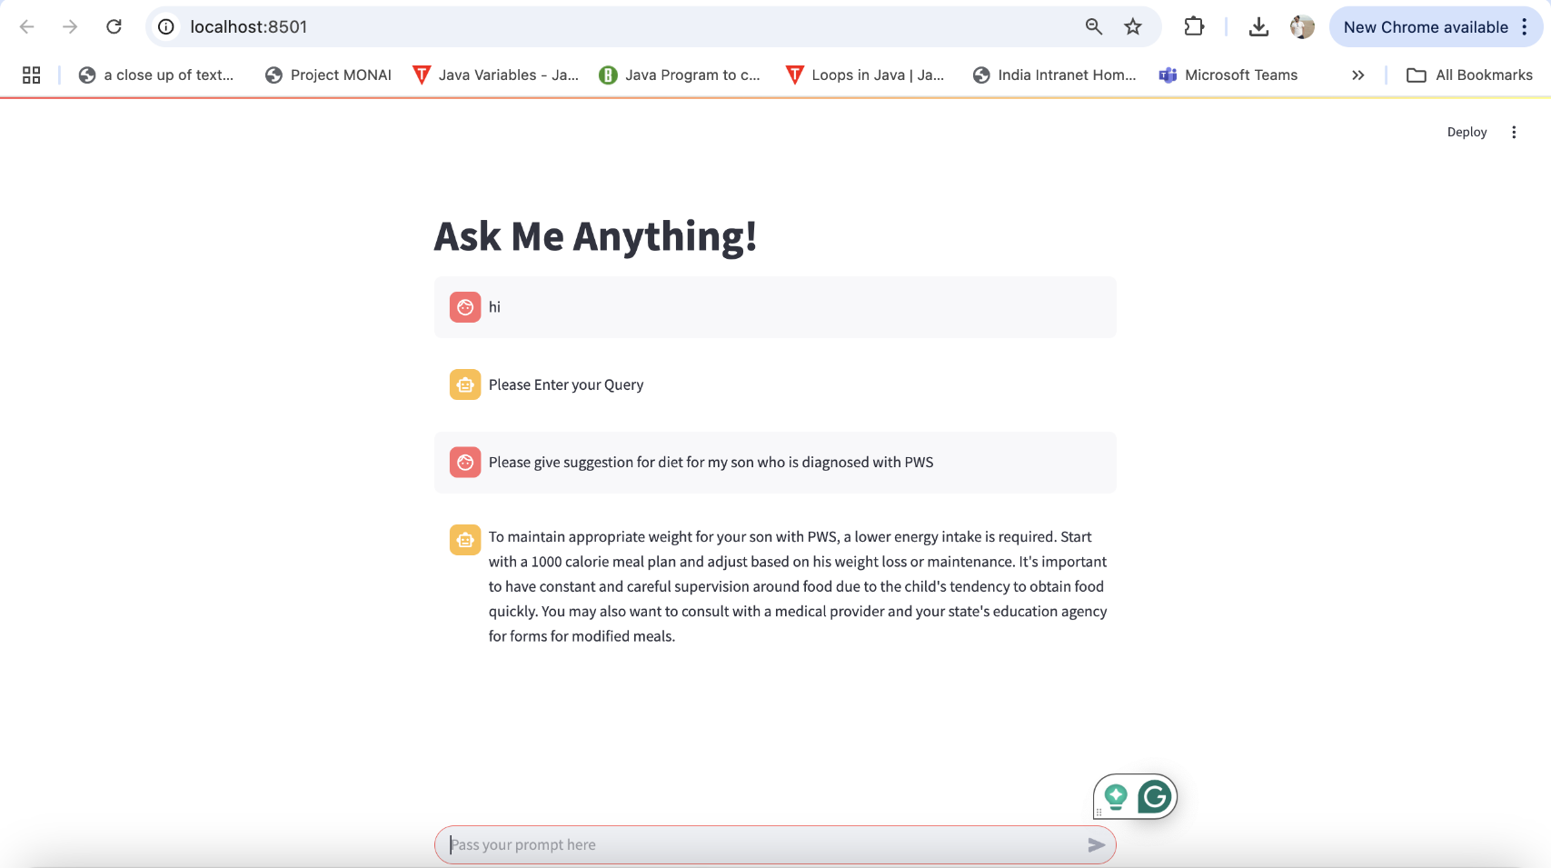
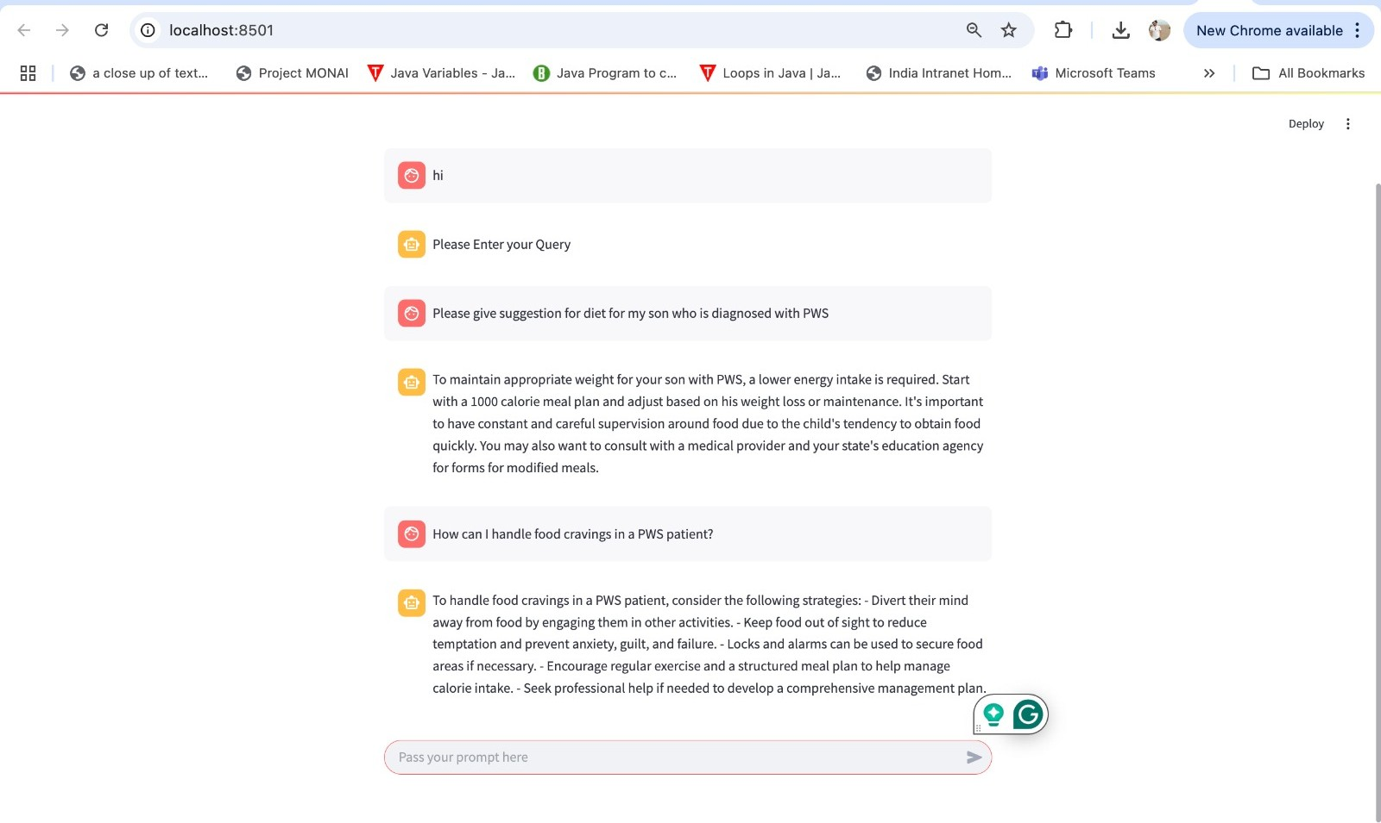
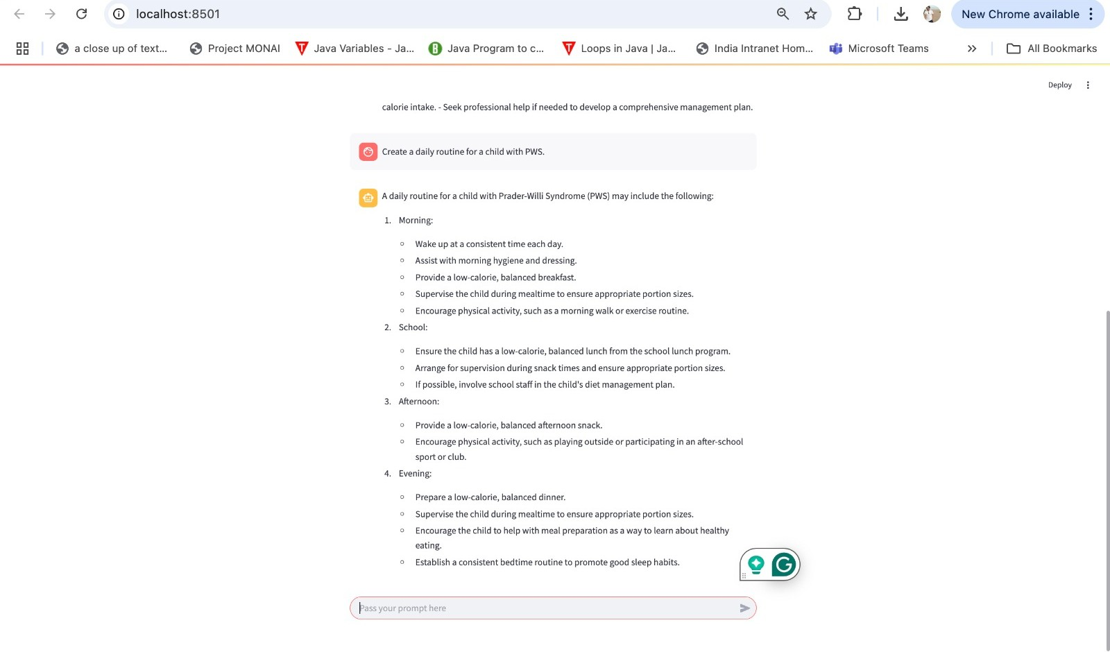
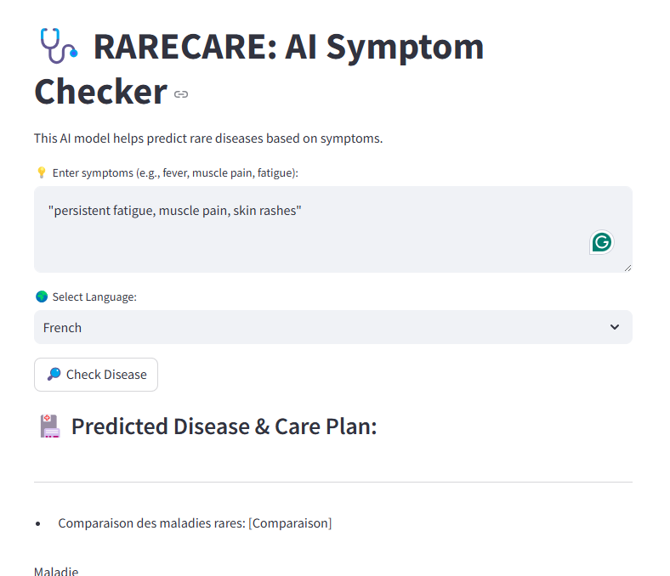
RESULT

Slide 7
DISCUSSION
Hospitals & Researchers: Utilize our AI-driven insights for better diagnosis & treatment planning.
NGOs & Rare Disease Advocates: Integrate PraderCare into your patient support programs.
Caregivers & Families: Access real-time, AI-powered guidance and support to ease your daily caregiving journey.

Slide 8
CHALLENGES & FUTURE DIRECTIONS
The challenge is the lack of proper data and limited data
Future directions can be:
AI Fine-Tuning with Real-World Patient Data
Expanding to Other Rare Diseases
Cloud-Enabled AI for Scalability

Slide 9
THANK YOU

